Slide 1


MIN 300 (Spring 2022-23)
INDIAN INSTITUTE OF TECHNOLOGY ROORKEE
Mid-term Evaluation
Machine Learning analysis of COP variation of ground coupled split AC system
Group Number:
33
Members
Mayank (20117076)
Himanshu (20117050)
Rahul Meena (20117097)
Sahil Yadav (20117105)
Harshit Solanki (20117058)
Supervisor
Prof. K. Murugesan

Slide 2
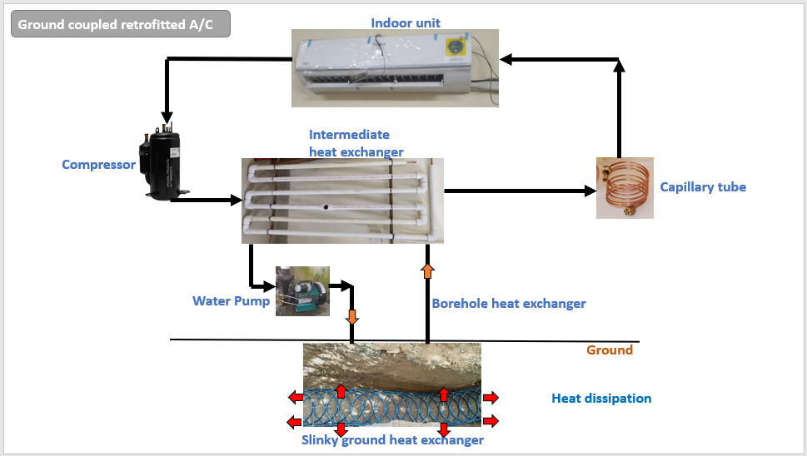
Introduction
The COP of ground coupled split Air-conditioning system varies continuously during the operation of the system.
Problem statement/objective :
Machine Learning analysis of COP variation of ground coupled split AC system
2

Slide 3
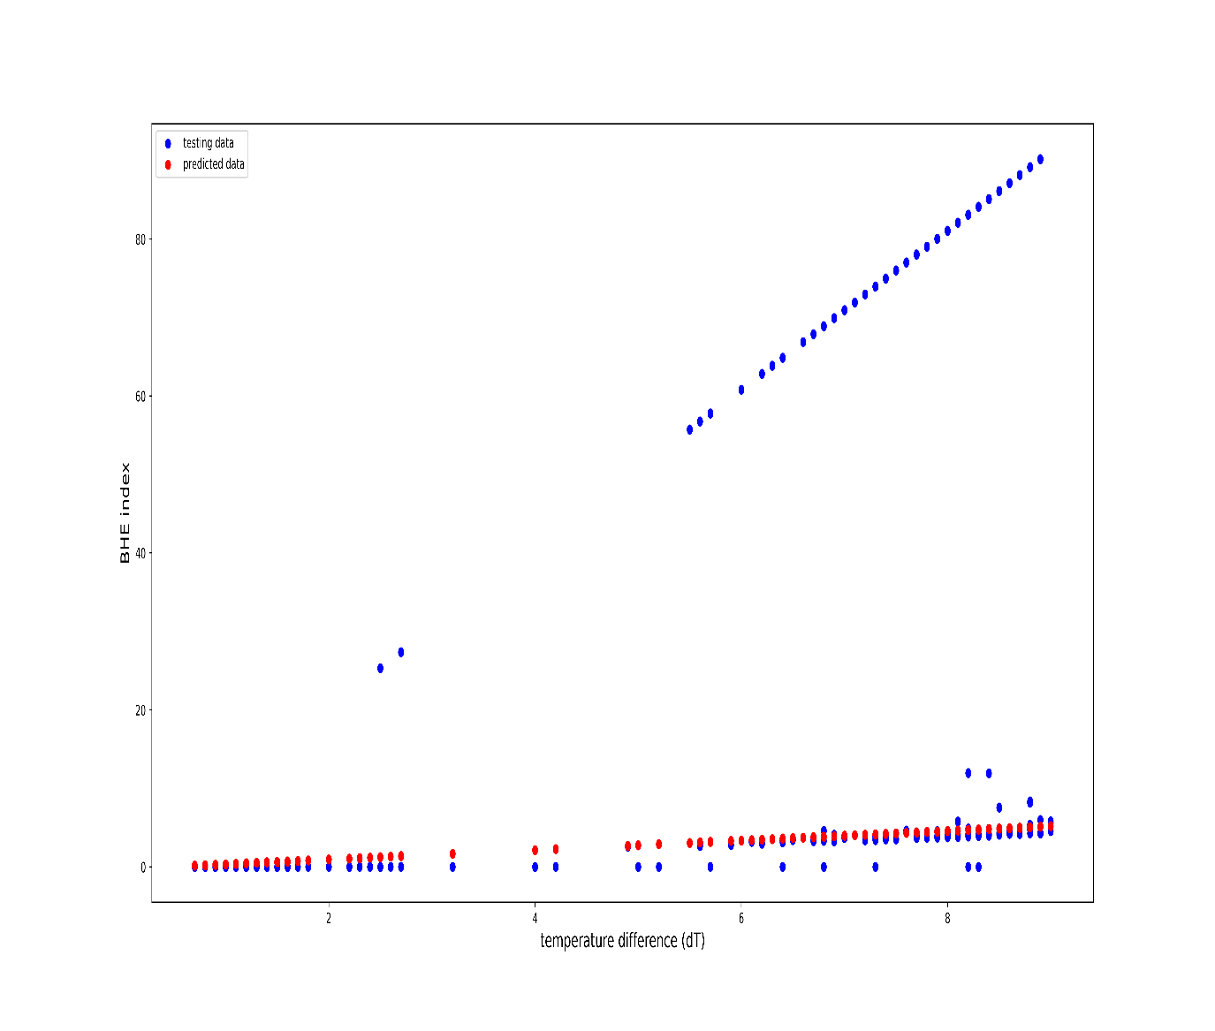
INITIAL RESULT

Slide 4
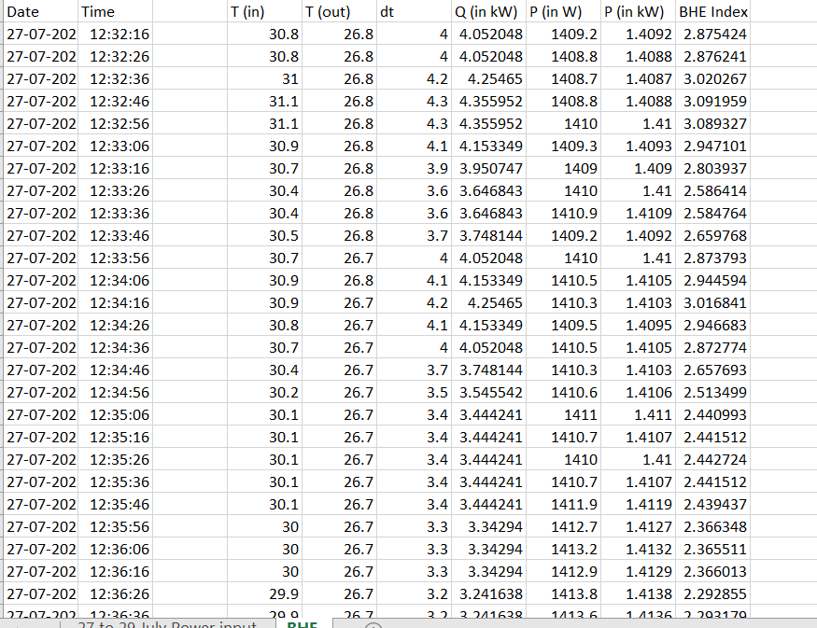
DATA TABLE

Slide 5
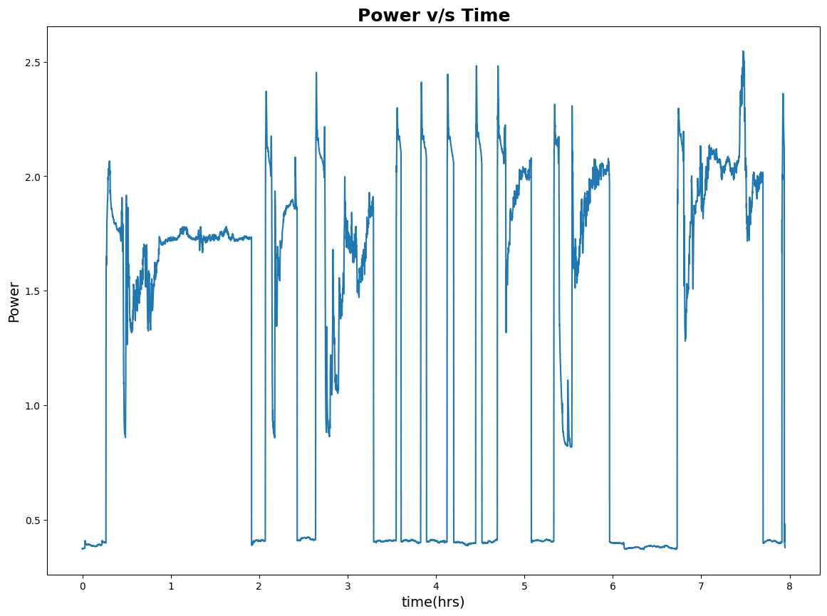
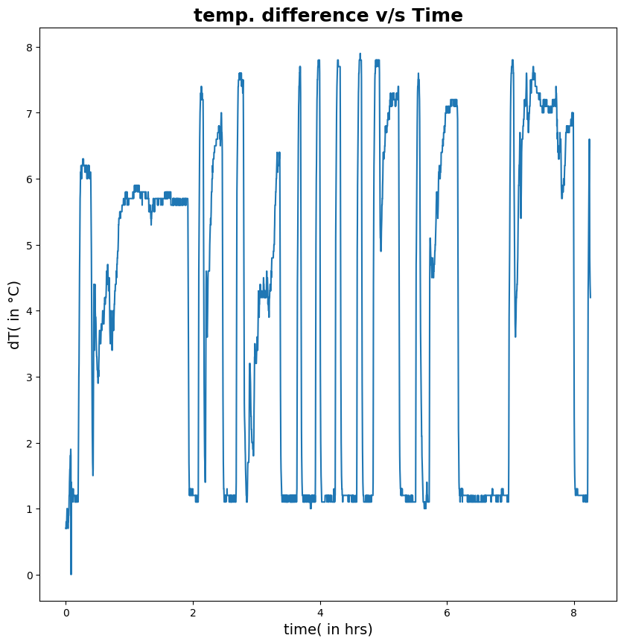
Graphs for our data

Slide 6
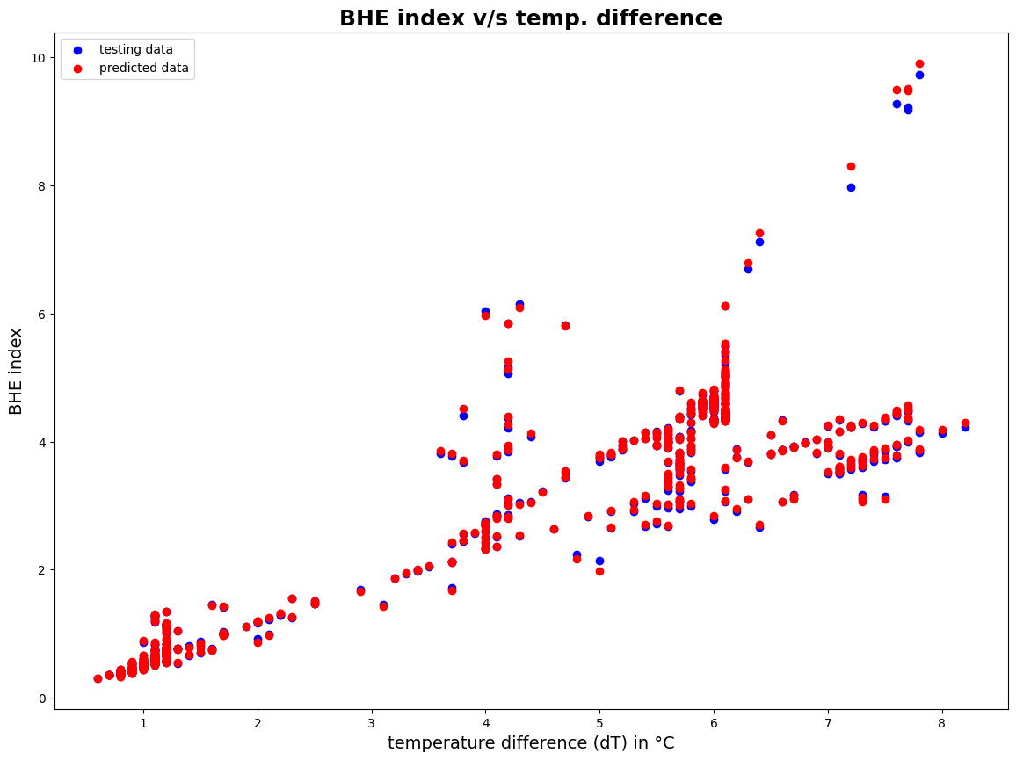
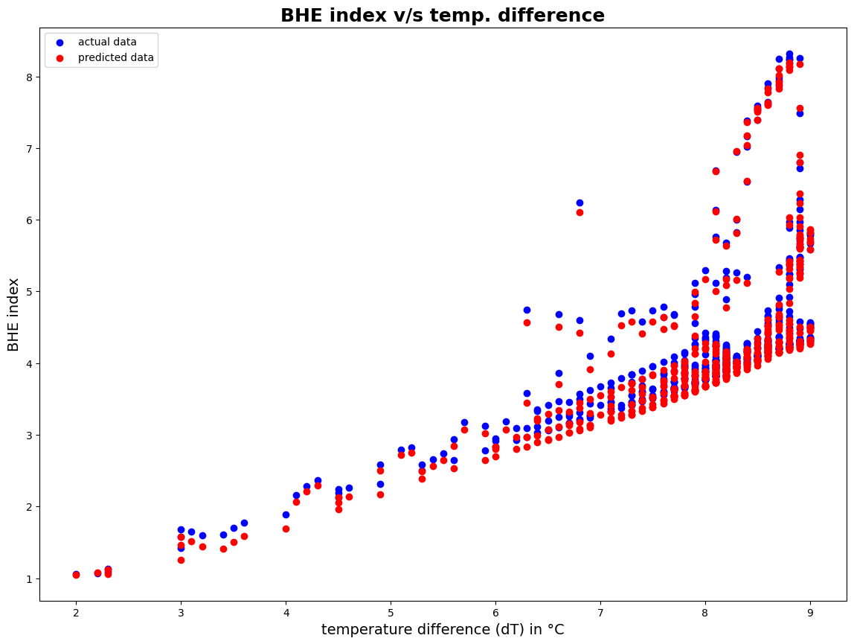

Slide 7
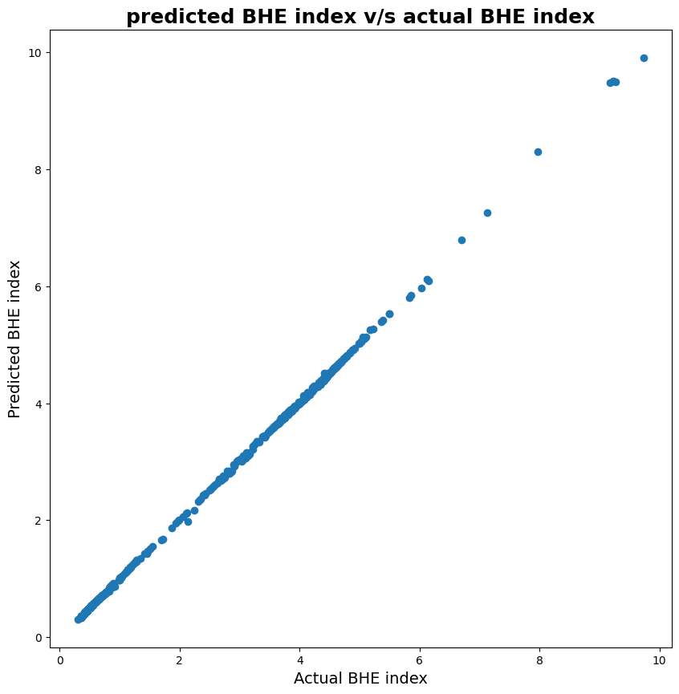
TESTING DATA LOSS =0.004676
NEW DATASET LOSS =0.139236

Slide 8
Thank you.

